Slide 1
Causal Models --Counterfactuals

Slide 2
Outline
Counterfactuals Basics
Important Application: Mediation
Representative Works

Slide 3
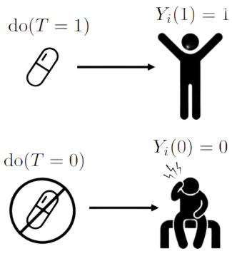
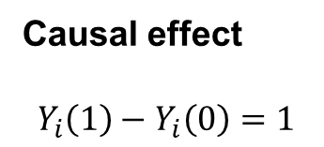
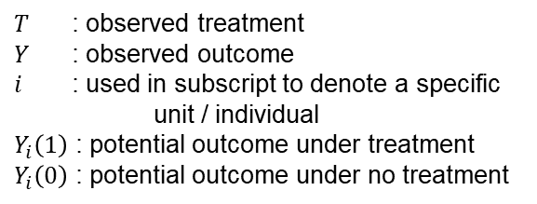
Fundamental Problem of Causal Inference
$T$ : observed treatment
$Y$ : observed outcome
$i$ : used in subscript to denote a specific unit / individual
$Y_{i}\left(1\right)$ : potential outcome under treatment
$Y_{i}\left(0\right)$ : potential outcome under no treatment
Causal effect
$$Y_{i}\left(1\right)−Y_{i}\left(0\right)=1$$

Slide 4
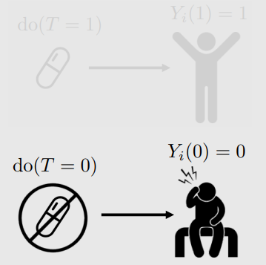
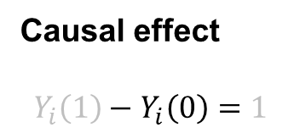
Fundamental Problem of Causal Inference
$T$ : observed treatment
$Y$ : observed outcome
$i$ : used in subscript to denote a specific unit / individual
$Y_{i}\left(1\right)$ : potential outcome under treatment
$Y_{i}\left(0\right)$ : potential outcome under no treatment
Counterfactual
Causal effect
$$Y_{i}\left(1\right)−Y_{i}\left(0\right)=1$$
Factual

Slide 5
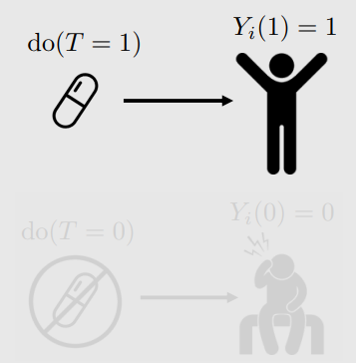
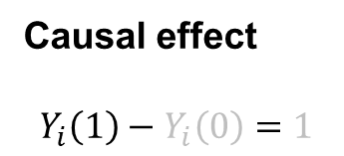
Fundamental Problem of Causal Inference
$T$ : observed treatment
$Y$ : observed outcome
$i$ : used in subscript to denote a specific unit / individual
$Y_{i}\left(1\right)$ : potential outcome under treatment
$Y_{i}\left(0\right)$ : potential outcome under no treatment
Factual
Causal effect
$$Y_{i}\left(1\right)−Y_{i}\left(0\right)=1$$
Counterfactual

Slide 6
We can compute counterfactuals using a parametric SCM.

Slide 7
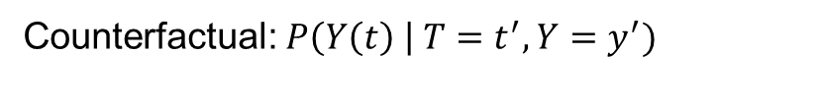
Counterfactuals
Counterfactual: $P\left(Y\left(t\right) \right| T=t^{′},Y=y^{′})$

Slide 8
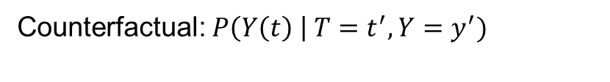
Counterfactuals
observation
Counterfactual: $P\left(Y\left(t\right) \right| T=t^{′},Y=y^{′})$

Slide 9
Counterfactuals
observation
Counterfactual: $P\left(Y\left(t\right) \right| T=t^{′},Y=y^{′})$
hypothetical condition

Slide 10

Counterfactuals
observation
Counterfactual: $P\left(Y\left(t\right) \right| T=t^{′},Y=y^{′})$
hypothetical condition
Different from CATE: $E\left[Y\left(t\right) \right| X=x]$

Slide 11
Counterfactuals
observation
Counterfactual: $P\left(Y\left(t\right) \right| T=t^{′},Y=y^{′})$
hypothetical condition
Different from CATE: $E\left[Y\left(t\right) \right| X=x]=E\left[Y \right| do\left(t\right),X=x]$
Cannot express counterfactuals using do-notation

Slide 12
Roadmap for Computing Counterfactuals
Given: Observation of (T,Y) (observation of potential outcome Y(t) where t is the observed value of T)

Slide 13
Roadmap for Computing Counterfactuals
Given: Observation of (T,Y) (observation of potential outcome Y(t) where t is the observed value of T)
Main ingredient necessary: correct parametric model for the structural equation for Y

Slide 14
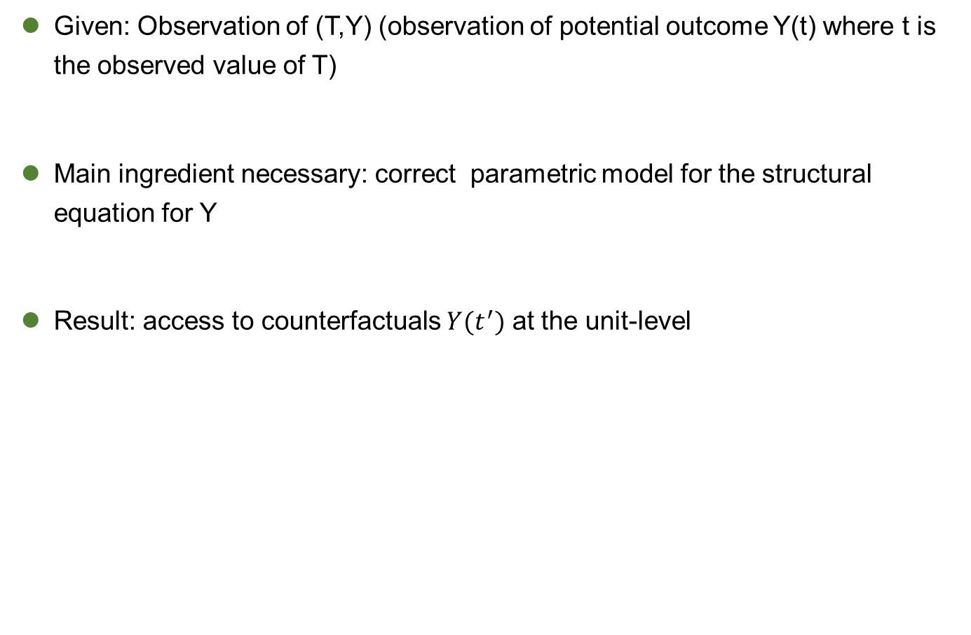
Roadmap for Computing Counterfactuals
Given: Observation of (T,Y) (observation of potential outcome Y(t) where t is the observed value of T)
Main ingredient necessary: correct parametric model for the structural equation for Y
Result: access to counterfactuals $Y(t^{′})$ at the unit-level

Slide 15

Computing Counterfactuals: Simple Example
Y: happy or unhappy (1 or 0)
T: get a dog or don’t (1 or 0)
U: unobserved variable describing the individual(1 if dog person; 0 if anti-dog person)
SCM: $T≔ …$ Observation: T = 0 and Y = 0 ${(Y}_{u}\left(0\right)=0)$
$Y ≔UT+(1−U)(1−T)$

Slide 16

Computing Counterfactuals: Simple Example
Y: happy or unhappy (1 or 0)
T: get a dog or don’t (1 or 0)
U: unobserved variable describing the individual(1 if dog person; 0 if anti-dog person)
SCM: $T≔ …$ Observation: T = 0 and Y = 0 ${(Y}_{u}\left(0\right)=0)$
$Y ≔UT+(1−U)(1−T)$ $Y_{u}\left(1\right)$?

Slide 17

Computing Counterfactuals: Simple Example
Y: happy or unhappy (1 or 0)
T: get a dog or don’t (1 or 0)
U: unobserved variable describing the individual(1 if dog person; 0 if anti-dog person)
SCM: $T≔ …$ Observation: T = 0 and Y = 0 ${(Y}_{u}\left(0\right)=0)$
$Y ≔UT+(1−U)(1−T)$ $Y_{u}\left(1\right)$?
Step1: Solve for U

Slide 18

Computing Counterfactuals: Simple Example
Y: happy or unhappy (1 or 0)
T: get a dog or don’t (1 or 0)
U: unobserved variable describing the individual(1 if dog person; 0 if anti-dog person)
SCM: $T≔ …$ Observation: T = 0 and Y = 0 ${(Y}_{u}\left(0\right)=0)$
$Y ≔UT+(1−U)(1−T)$ $Y_{u}\left(1\right)$?
Step1: Solve for U
$0=U∙0+\left(1−U\right)\left(1−0\right)$
$U=1$

Slide 19

Computing Counterfactuals: Simple Example
Y: happy or unhappy (1 or 0)
T: get a dog or don’t (1 or 0)
U: unobserved variable describing the individual(1 if dog person; 0 if anti-dog person)
SCM: $T≔ …$ Observation: T = 0 and Y = 0 ${(Y}_{u}\left(0\right)=0)$
$Y ≔UT+(1−U)(1−T)$ $Y_{u}\left(1\right)$?
Step1: Solve for U
Step2: Individualized SCM $0=U∙0+\left(1−U\right)\left(1−0\right)$
$T≔…$ $U=1$
$Y≔1∙T+(1−1)(1−T)$
$Y≔T$

Slide 20
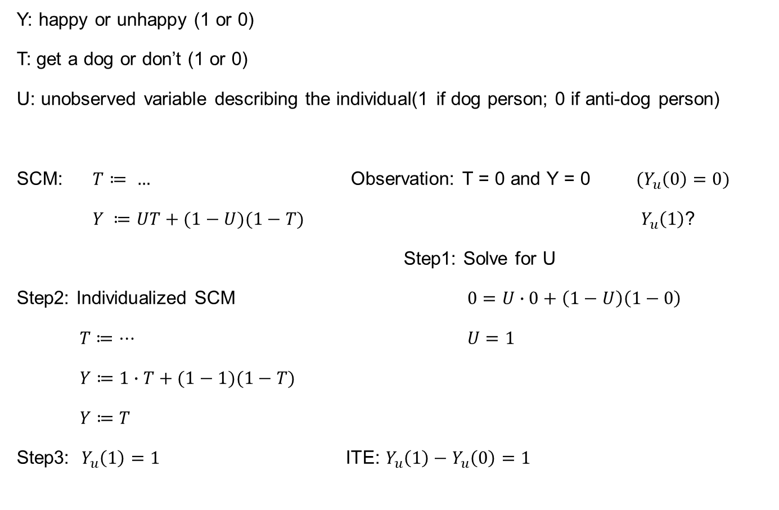
Computing Counterfactuals: Simple Example
Y: happy or unhappy (1 or 0)
T: get a dog or don’t (1 or 0)
U: unobserved variable describing the individual(1 if dog person; 0 if anti-dog person)
SCM: $T≔ …$ Observation: T = 0 and Y = 0 ${(Y}_{u}\left(0\right)=0)$
$Y ≔UT+(1−U)(1−T)$ $Y_{u}\left(1\right)$?
Step1: Solve for U
Step2: Individualized SCM $0=U∙0+\left(1−U\right)\left(1−0\right)$
$T≔…$ $U=1$
$Y≔1∙T+(1−1)(1−T)$
$Y≔T$
Step3: $Y_{u}\left(1\right)=1$ ITE: $Y_{u}\left(1\right)−Y_{u}\left(0\right)=1$

Slide 21
General Steps for Deterministic Counterfactuals
From Chapter 4 of Pearl et al. (2016)’s Primer:
Abduction: Use an observation to determine the value of U
Action: Modify the SCM, by replacing the structural equation for T with T := t
Prediction: Use the value of U from step 1 and the modified SCM from step 2 to compute the value of Y(t)

Slide 22

Question:
Given the observation T = 1 and Y = 0, compute Y(0) for this individual given the following SCM:
$T≔…$
$Y≔UT+(1−U)(1−T)$

Slide 23
Can’t Always Determine Counterfactual
Even when we have the structural equation for Y, we can’t always determine counterfactuals with probability 1

Slide 24
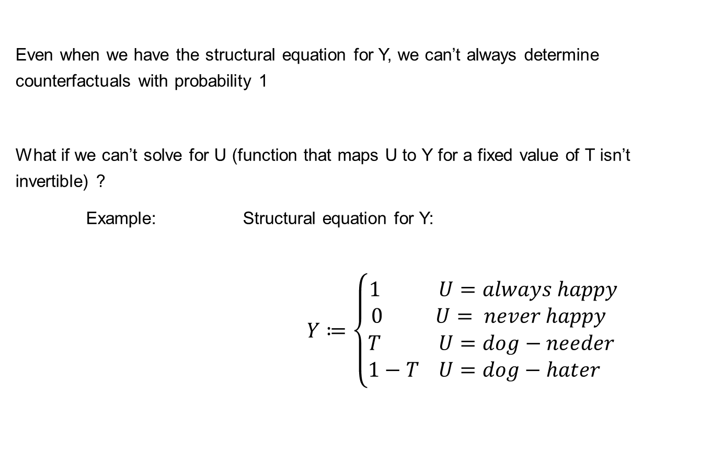
Can’t Always Determine Counterfactual
Even when we have the structural equation for Y, we can’t always determine counterfactuals with probability 1
What if we can’t solve for U (function that maps U to Y for a fixed value of T isn’t invertible) ?
Example: Structural equation for Y:
$Y≔\left\{\begin{aligned}1 U=always happy \\ 0 U= never happy \\ T U=dog−needer \\ 1−T U=dog−hater \end{aligned}\right.$

Slide 25
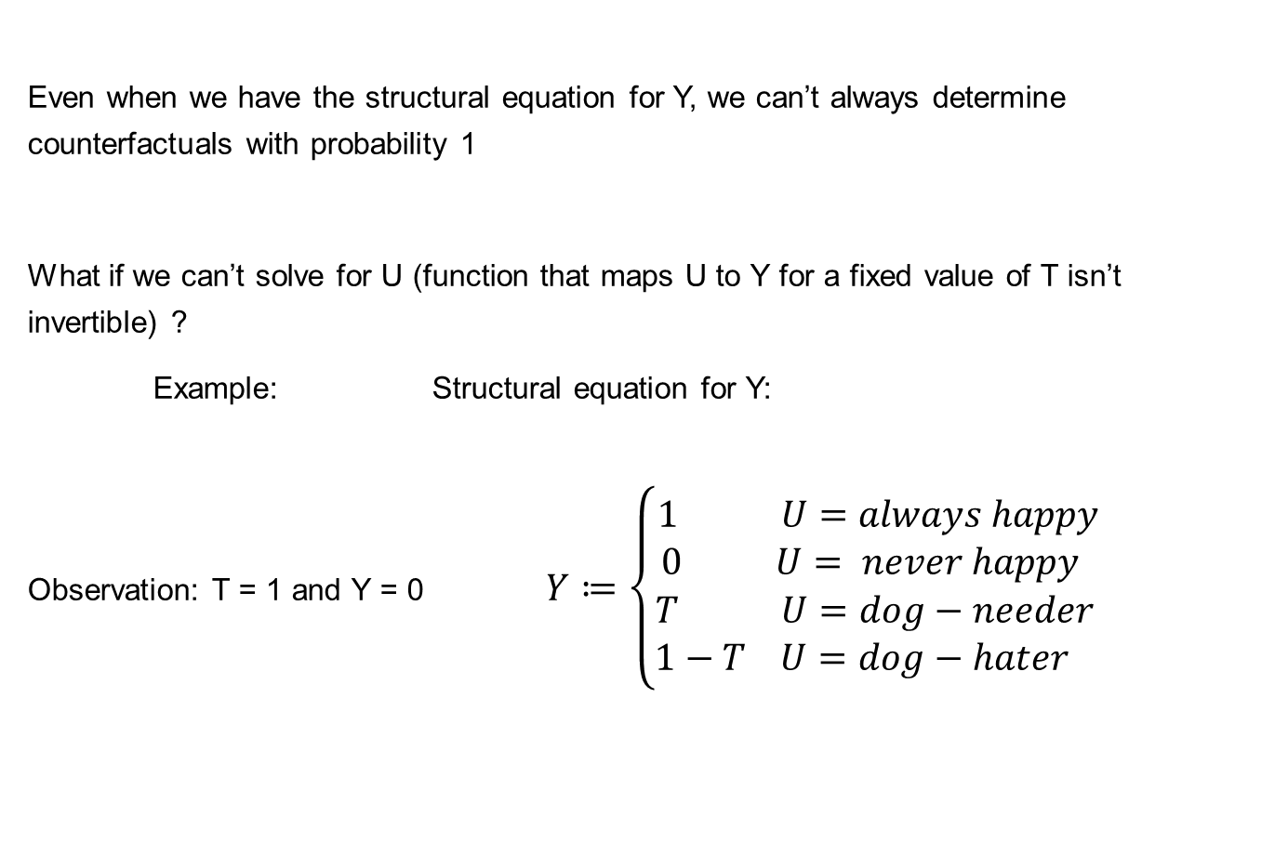
Can’t Always Determine Counterfactual
Even when we have the structural equation for Y, we can’t always determine counterfactuals with probability 1
What if we can’t solve for U (function that maps U to Y for a fixed value of T isn’t invertible) ?
Example: Structural equation for Y:
Observation: T = 1 and Y = 0 $Y≔\left\{\begin{aligned}1 U=always happy \\ 0 U= never happy \\ T U=dog−needer \\ 1−T U=dog−hater \end{aligned}\right.$

Slide 26


Non-Invertible Example
Structural equation for Y:
Observation: T = 1 and Y = 0
($Y_{u}\left(1\right)=0$)
($Y_{u}\left(0\right)= ?$)
$$Y≔\left\{\begin{aligned}1 U=always happy \\ 0 U= never happy \\ T U=dog−needer \\ 1−T U=dog−hater \end{aligned}\right.$$

Slide 27

Non-Invertible Example
Structural equation for Y:
$P\left(U=always happy\right)=0.3$
$P\left(U=never happy\right)=0.2$
$P\left(U=dog−needer\right)=0.4$
$P\left(U=dog−hater\right)=0.1$
Observation: T = 1 and Y = 0
($Y_{u}\left(1\right)=0$)
($Y_{u}\left(0\right)= ?$)
$$Y≔\left\{\begin{aligned}1 U=always happy \\ 0 U= never happy \\ T U=dog−needer \\ 1−T U=dog−hater \end{aligned}\right.$$

Slide 28

Non-Invertible Example
Structural equation for Y:
$P\left(U=always happy\right)=0.3$
$P\left(U=never happy\right)=0.2$
$P\left(U=dog−needer\right)=0.4$
$P\left(U=dog−hater\right)=0.1$
Observation: T = 1 and Y = 0 $P\left(U=never happy \right| T=1,Y=0)=\frac{0.2}{0.2+0.1}=\frac{2}{3}$
($Y_{u}\left(1\right)=0$) $P\left(U=dog−hater \right| T=1,Y=0)=\frac{0.1}{0.2+0.1}=\frac{1}{3}$
($Y_{u}\left(0\right)= ?$) $P\left(Y_{u}\left(0\right)=1\right)=\frac{1}{3},P\left(Y_{u}\left(0\right)=0\right)=\frac{2}{3}$
$$Y≔\left\{\begin{aligned}1 U=always happy \\ 0 U= never happy \\ T U=dog−needer \\ 1−T U=dog−hater \end{aligned}\right.$$

Slide 29
General Steps for Probabilistic Counterfactuals
From Chapter 4 of Pearl et al. (2016)’s Primer:
Abduction: Use an observation Z to update the distribution of U: P(U | Z)

Slide 30
General Steps for Probabilistic Counterfactuals
From Chapter 4 of Pearl et al. (2016)’s Primer:
Abduction: Use an observation Z to update the distribution of U: P(U | Z)
Action: Modify the SCM, by replacing the structural equation for T with T := t

Slide 31
General Steps for Probabilistic Counterfactuals
From Chapter 4 of Pearl et al. (2016)’s Primer:
Abduction: Use an observation Z to update the distribution of U: P(U | Z)
Action: Modify the SCM, by replacing the structural equation for T with T := t
Prediction: Use the updated distribution of U step 1 and the modified SCM from step 2 to compute the distribution of Y(t)

Slide 32
No Unit-level Counterfactuals without Parametric Model
Main ingredient necessary for computing counterfactuals: parametric model for the structural equation for Y
Having such a parametric model is a strong assumption.
Without it, we are stuck with the fundamental problem of causal inference.

Slide 33


Question
Given the observation T = 1 and Y = 1, compute Y(0) for this individual given the following SCM and prior:
$P\left(U=always happy\right)=0.3$
$P\left(U=never happy\right)=0.2$
$P\left(U=dog−needer\right)=0.4$
$P\left(U=dog−hater\right)=0.1$
$$Y≔\left\{\begin{aligned}1 U=always happy \\ 0 U= never happy \\ T U=dog−needer \\ 1−T U=dog−hater \end{aligned}\right.$$

Slide 34

Population-level Doesn’t Require a Parametric Model
Population-level counterfactual: $E\left[Y\left(t\right) \right| T=t′]$
Just like we were able to identify the ATE $E[Y\left(1\right) −Y(0)]$ nonparametrically (using just the causal graph), we can do the same with population-level counterfactual quantities, if they are identifiable

Slide 35
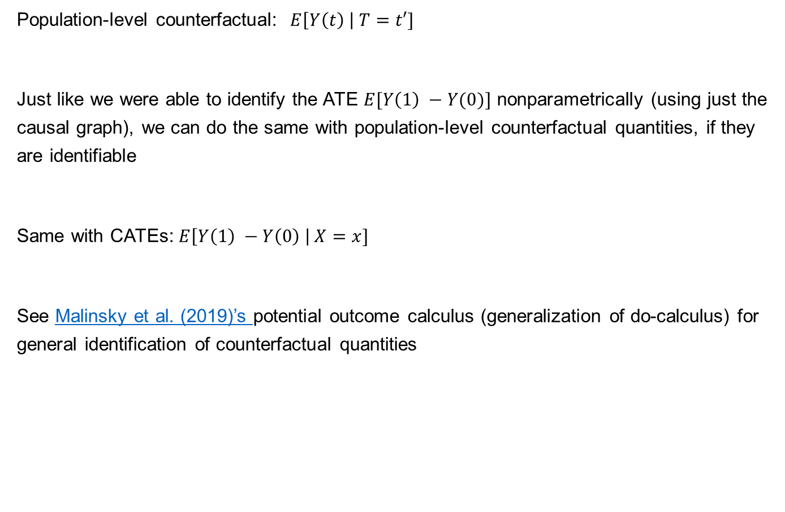
Population-level Doesn’t Require a Parametric Model
Population-level counterfactual: $E\left[Y\left(t\right) \right| T=t′]$
Just like we were able to identify the ATE $E[Y\left(1\right) −Y(0)]$ nonparametrically (using just the causal graph), we can do the same with population-level counterfactual quantities, if they are identifiable
Same with CATEs: $E\left[Y\left(1\right) −Y\left(0\right) \right| X=x]$
See Malinsky et al. (2019)’s potential outcome calculus (generalization of do-calculus) for general identification of counterfactual quantities

Slide 36
Outline
Counterfactuals Basics
Important Application: Mediation
Representative Works

Slide 37
Mediation
Happiness
Get dog

Slide 38
Mediation
Indirect effect
Walk more
Happiness
Get dog
Direct effect

Slide 39
Mediation
Indirect effect
Walk more
Happiness
Get dog
More
friends
Direct effect

Slide 40
Mediation
Indirect effect
Walk more
Happiness
Get dog
More
friends
Direct effect
How can we measure the direct effect?

Slide 41



Controlled Direct Effect (CDE)
$$M$$
$$T$$
$$Y$$

Slide 42

Controlled Direct Effect (CDE)
Condition on m
$$M$$
$$T$$
$$Y$$
$$E\left[Y \right| do(T=1,) M=m]−E[Y | do\left(T=0\right),M=m]$$

Slide 43
Controlled Direct Effect (CDE)
intervene on m
$$M$$
$$T$$
$$Y$$
$$E\left[Y \right| do(T=1,) M=m]−E[Y | do\left(T=0\right),M=m]$$
Condition on m could open up other paths

Slide 44
Controlled Direct Effect (CDE)
intervene on m
$$M$$
$$T$$
$$Y$$
$$E\left[Y \right| do(T=1,) M=m]−E[Y | do\left(T=0\right),M=m]$$
$$E\left[Y \right| do(T=1, M=m)]−E[Y | do(T=0,M=m)]$$
We do m then we remove all incoming edges to m
And then we’ve effectively isolated the flow of causation from t to y in this graph
This is known as controlled direct effect

Slide 45
Controlled Direct Effect (CDE)
Problems:
CDE is specific to the arbitrary choice of m
How do we get the indirect effect? Can’t just subtract the CDE from the total effect?
$$M$$
$$T$$
$$Y$$
$$E\left[Y \right| do(T=1,) M=m]−E[Y | do\left(T=0\right),M=m]$$
$$E\left[Y \right| do(T=1, M=m)]−E[Y | do(T=0,M=m)]$$

Slide 46

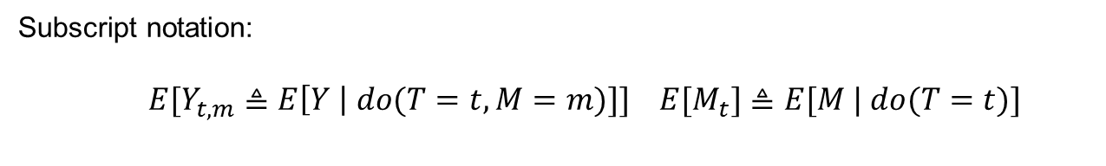
Natural Direct and Indirect Effects
Subscript notation:
$E[Y_{t,m}≜E\left[Y \right| do(T=t,M=m)]] E[M_{t}]≜E[M | do(T=t)]$
$$CDE≜E[Y_{1,m}−Y_{0,m}]$$

Slide 47




Natural Direct and Indirect Effects
Subscript notation:
$E[Y_{t,m}≜E\left[Y \right| do(T=t,M=m)]] E[M_{t}]≜E[M | do(T=t)]$
$$CDE≜E[Y_{1,m}−Y_{0,m}]$$
$$NDE≜E[Y_{1,M_{0}}−Y_{0,M_{0}}]$$
$$NIE≜E[Y_{0,M_{1}}−Y_{0,M_{0}}]$$

Slide 48


Natural Direct and Indirect Effects
Subscript notation:
$E[Y_{t,m}≜E\left[Y \right| do(T=t,M=m)]] E[M_{t}]≜E[M | do(T=t)]$
For example in linear setting, $TE=NDE+NIE$
$$CDE≜E[Y_{1,m}−Y_{0,m}]$$
Recall problems with CDE:
CDE is specific to the arbitrary choice of m
How do we get the indirect effect? Can’t just subtract the CDE from the total effect
$$NDE≜E[Y_{1,M_{0}}−Y_{0,M_{0}}]$$
$$NIE≜E[Y_{0,M_{1}}−Y_{0,M_{0}}]$$
$$TE={NDE−NIE}_{r}$$

Slide 49

Question
Show that $TE={NDE−NIE}_{r}$, where ${NIE}_{r}≜E[Y_{1,M_{0}}−Y_{1,M_{1}}]$.

Slide 50
Comparison of Controlled vs. Natural Mediation
CDE can always be measured via experiments (do-operator), but it has no clear undirect effect since there is no decomposition
NDE cannot always be measured via experiments since it is counterfactual, but it allows for complete decomposition of the total effect into the NDE and NIE, which is what we’d like in mediation analysis

Slide 51
When We Can Measure NDE and NIE

Slide 52

When We Can Measure NDE and NIE
Adjustment set $W$
Sufficient conditions for identifying NDE:
No member of $W$ is a descendant of T
$W$ blocks all backdoor paths from M to Y

Slide 53

When We Can Measure NDE and NIE
Adjustment set $W$
Sufficient conditions for identifying NDE:
No member of $W$ is a descendant of T
$W$ blocks all backdoor paths from M to Y
$$NDE=\sum_{m}{\sum_{w}{\left(E\left[Y \right| do\left(T=1,M=m\right),W=w\right]−E\left[Y \right| do\left(T=0,M=m\right),W=w])}}$$
$×P\left(M=m | do\left(T=0\right),W=w\right)P(W=w)$

Slide 54
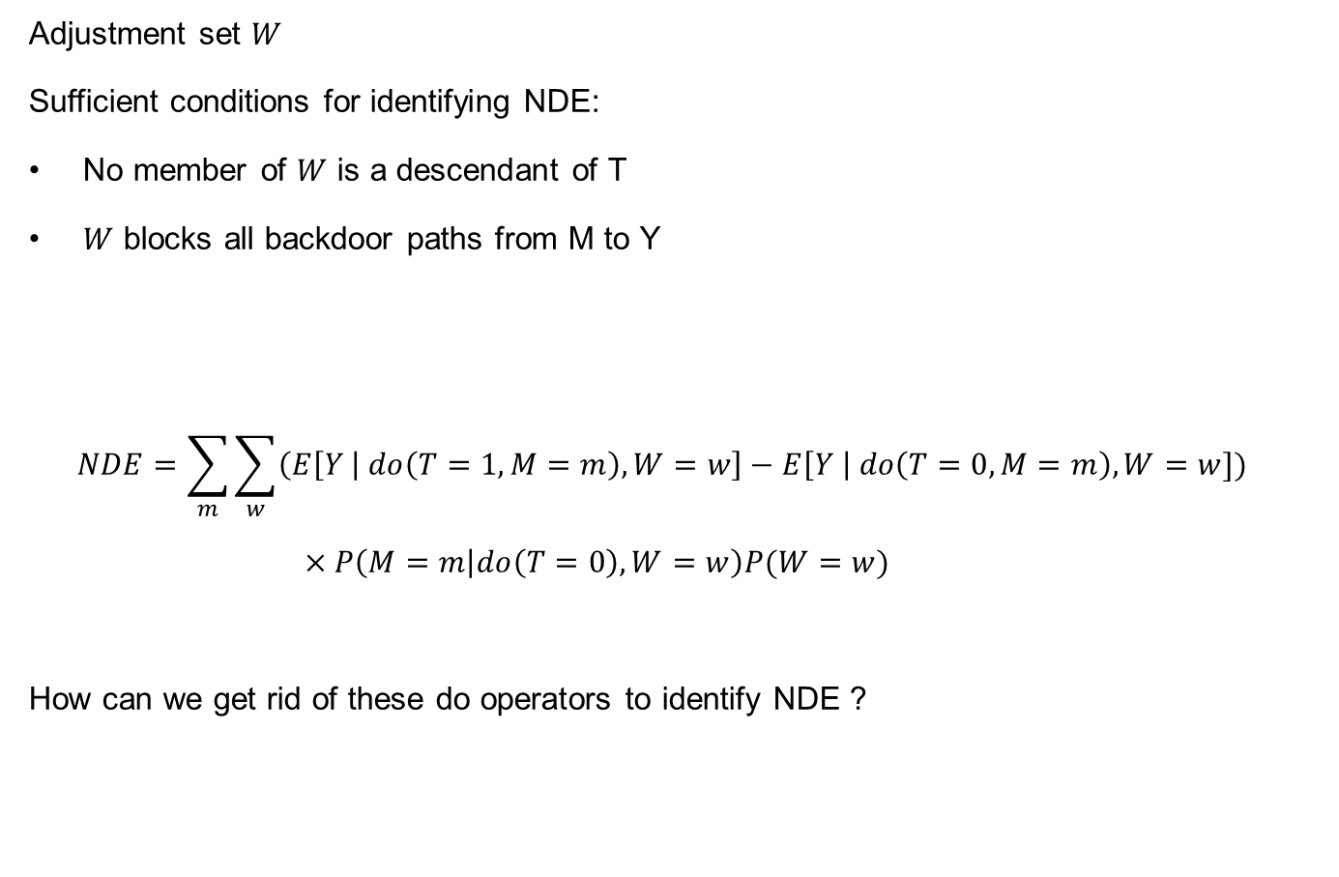
When We Can Measure NDE and NIE
Adjustment set $W$
Sufficient conditions for identifying NDE:
No member of $W$ is a descendant of T
$W$ blocks all backdoor paths from M to Y
$$NDE=\sum_{m}{\sum_{w}{\left(E\left[Y \right| do\left(T=1,M=m\right),W=w\right]−E\left[Y \right| do\left(T=0,M=m\right),W=w])}}$$
$×P\left(M=m | do\left(T=0\right),W=w\right)P(W=w)$
How can we get rid of these do operators to identify NDE ?

Slide 55
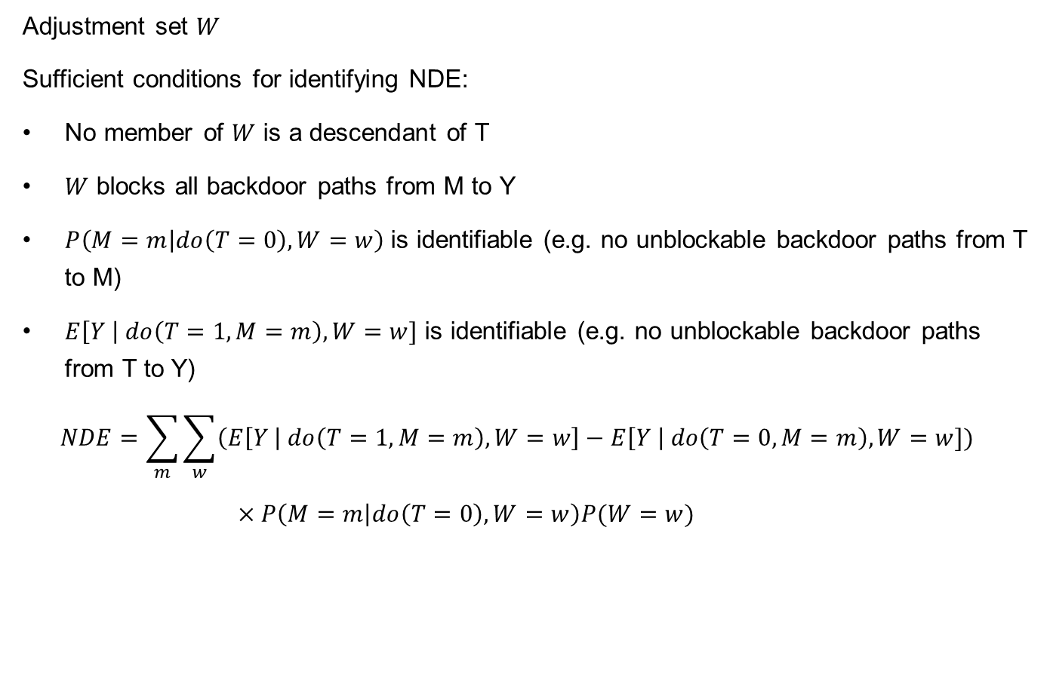
When We Can Measure NDE and NIE
Adjustment set $W$
Sufficient conditions for identifying NDE:
No member of $W$ is a descendant of T
$W$ blocks all backdoor paths from M to Y
$P\left(M=m | do\left(T=0\right),W=w\right)$ is identifiable (e.g. no unblockable backdoor paths from T to M)
$E\left[Y \right| do\left(T=1,M=m\right),W=w]$ is identifiable (e.g. no unblockable backdoor paths from T to Y)
$$NDE=\sum_{m}{\sum_{w}{\left(E\left[Y \right| do\left(T=1,M=m\right),W=w\right]−E\left[Y \right| do\left(T=0,M=m\right),W=w])}}$$
$×P\left(M=m | do\left(T=0\right),W=w\right)P(W=w)$

Slide 56
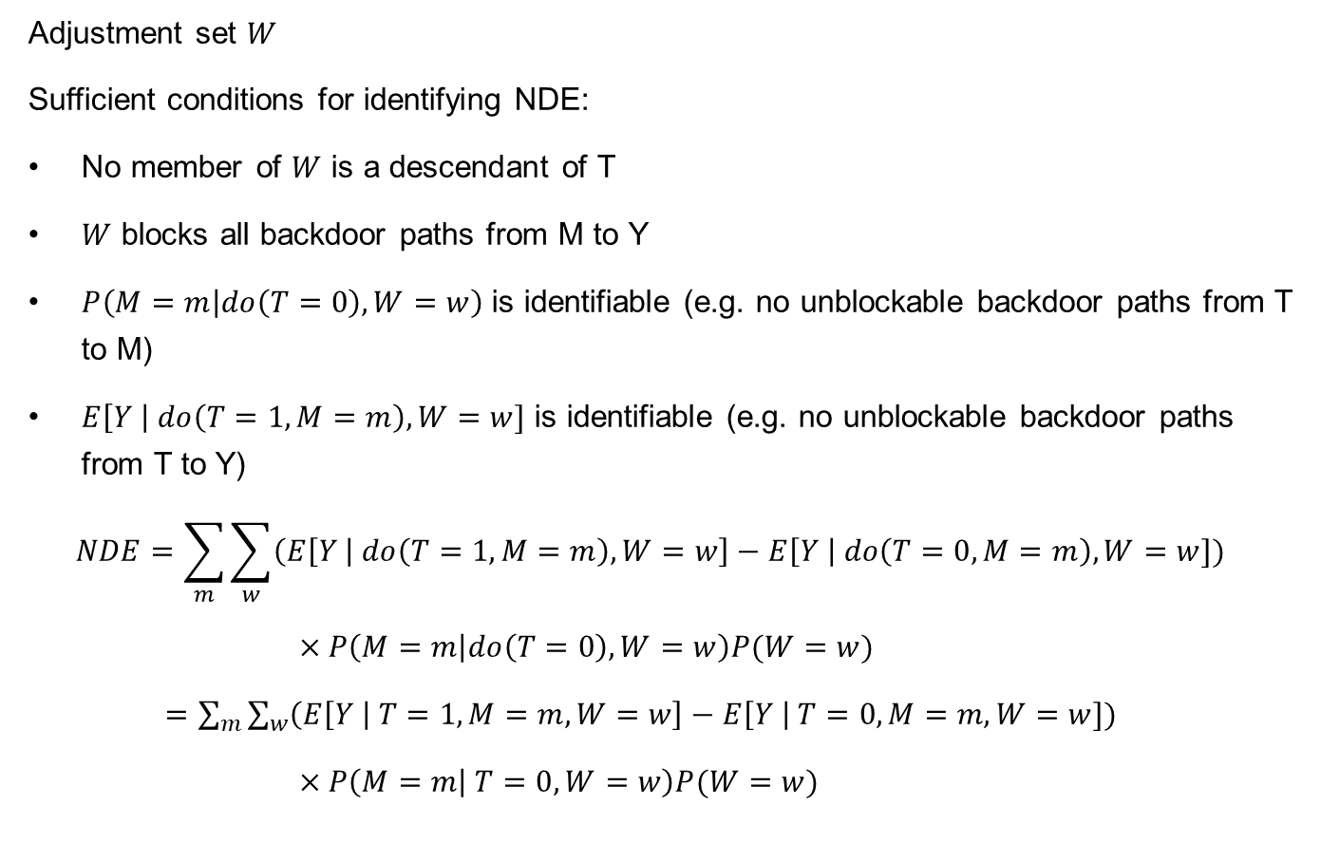
When We Can Measure NDE and NIE
Adjustment set $W$
Sufficient conditions for identifying NDE:
No member of $W$ is a descendant of T
$W$ blocks all backdoor paths from M to Y
$P\left(M=m | do\left(T=0\right),W=w\right)$ is identifiable (e.g. no unblockable backdoor paths from T to M)
$E\left[Y \right| do\left(T=1,M=m\right),W=w]$ is identifiable (e.g. no unblockable backdoor paths from T to Y)
$$NDE=\sum_{m}{\sum_{w}{\left(E\left[Y \right| do\left(T=1,M=m\right),W=w\right]−E\left[Y \right| do\left(T=0,M=m\right),W=w])}}$$
$×P\left(M=m | do\left(T=0\right),W=w\right)P(W=w)$
$=\sum_{m}{\sum_{w}{\left(E\left[Y \right| T=1,M=m,W=w\right]−E\left[Y \right| T=0,M=m,W=w])}}$
$×P\left(M=m | T=0,W=w\right)P(W=w)$

Slide 57
Question:
Come up with your own example of mediation and the corresponding graph. Then, determine whether you can identify the NDE and NIE from observation data.

Slide 58
Path-Specific Effects
Measure causal effects along arbitrary path or set of paths in the causal graph
See “Identifiability of Path-Specific Effects” (Avin et al.,2015)

Slide 59
Outline
Counterfactuals Basics
Important Application: Mediation
Representative Works

Slide 60
Representative Works
CV
Counterfactual VQA: A Cause-Effect Look at Language Bias (CVPR 2021)
Counterfactual Attention Learning for Fine-Grained Visual Categorization and Re-identification (ICCV 2021)
Counterfactual zero-shot and open-set visual recognition (CVPR 2021)
Counterfactual samples synthesizing for robust visual question answering (CVPR 2020)
Cycle-Consistent Counterfactuals by Latent Transformations (CVPR 2022)
Towards robust classification model by counterfactual and invariant data generation (CVPR 2021)

Slide 61
Representative Works
NLP
Counterfactual inference for text classification debiasing (ACL 2021)
DoCoGen: Domain Counterfactual Generation for Low Resource Domain Adaptation (ACL 2022)
Debiasing NLU models via Causal Intervention and Counterfactual Reasoning (AAAI 2022)
Counterfactuals to Control Latent Disentangled Text Representations for Style Transfer (ACL 2021)
Polyjuice: Generating counterfactuals for explaining, evaluating, and improving models (ACL 2021)

Slide 62
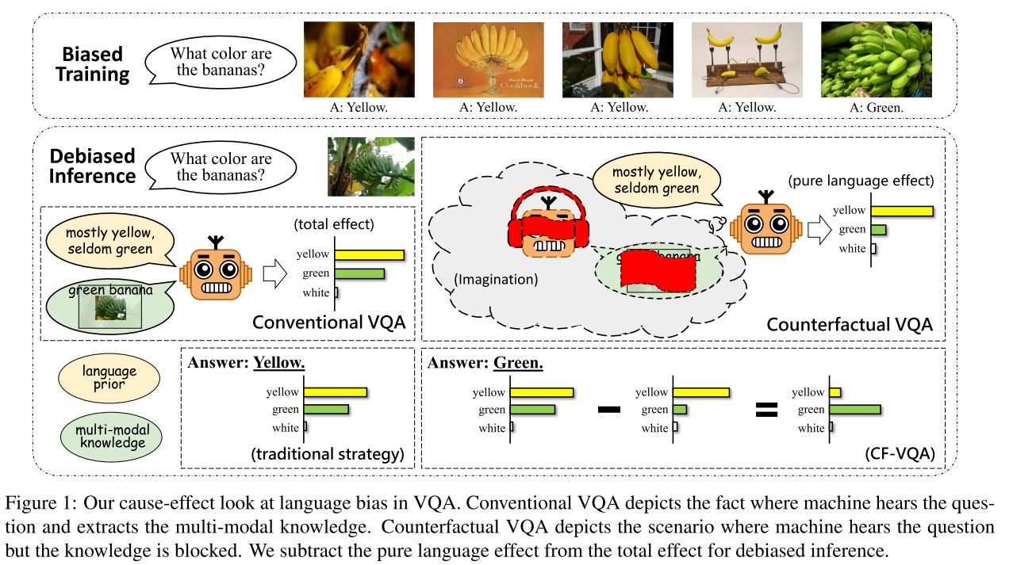
Representative Work1: Counterfactual VQA: A Cause-Effect Look at Language Bias
Motivation: 1) VQA models may rely on spurious linguistic correlations rather than multi-modal reasoning. 2) It will fail to generalize well if they simply memorize the strong language priors in the training data. 3) the goal is to mitigate language bias in VQA

Slide 63
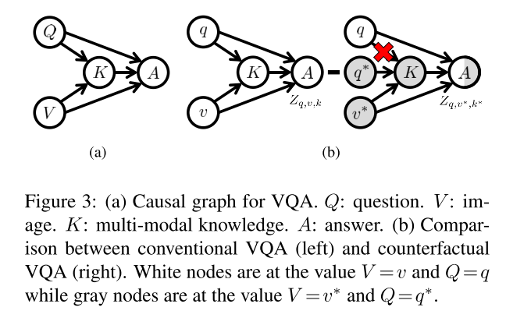


Representative Work1: Counterfactual VQA: A Cause-Effect Look at Language Bias
SCM and Method: capture the language bias as the direct causal effect of questions on answers and reduce the language bias by subtracting the direct language effect from the total causal effect

Slide 64
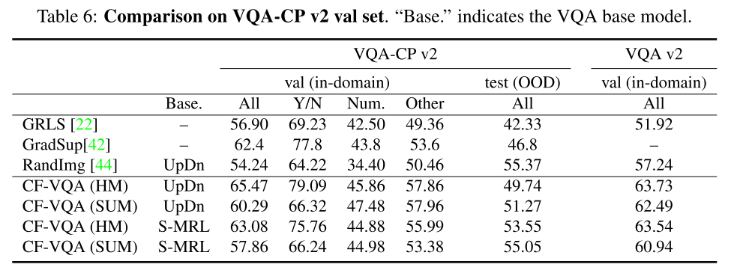
Representative Work1: Counterfactual VQA: A Cause-Effect Look at Language Bias
Experimental Performance

Slide 65
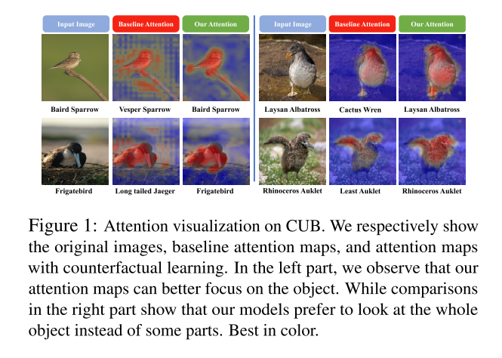
Representative Work2: Counterfactual Attention Learning for Fine-Grained Visual Categorization and Re-identification
Motivation: there are biases for both attributes and environment, which indicates either background and single part are not reliable clues for classification.

Slide 66
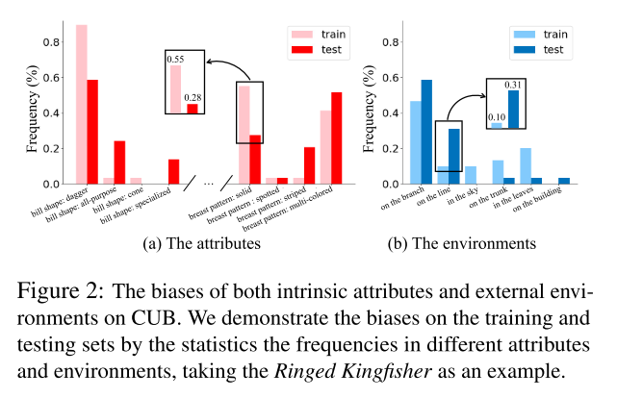
Representative Work2: Counterfactual Attention Learning for Fine-Grained Visual Categorization and Re-identification
Motivation: biases on the training and testing sets

Slide 67
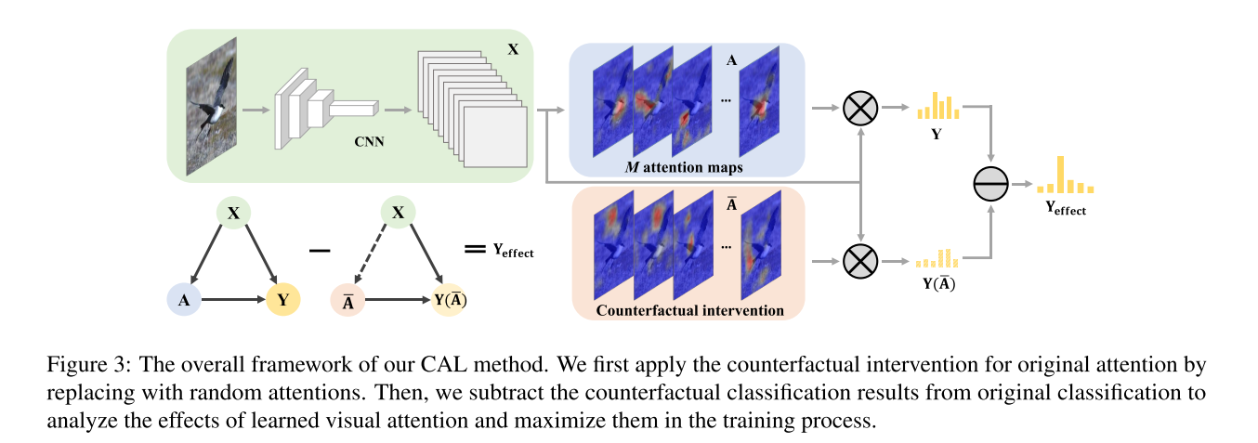
Representative Work2: Counterfactual Attention Learning for Fine-Grained Visual Categorization and Re-identification
SCM and Method: Adopt counterfactual intervention to investigate the effects of the learned visual attention

Slide 68
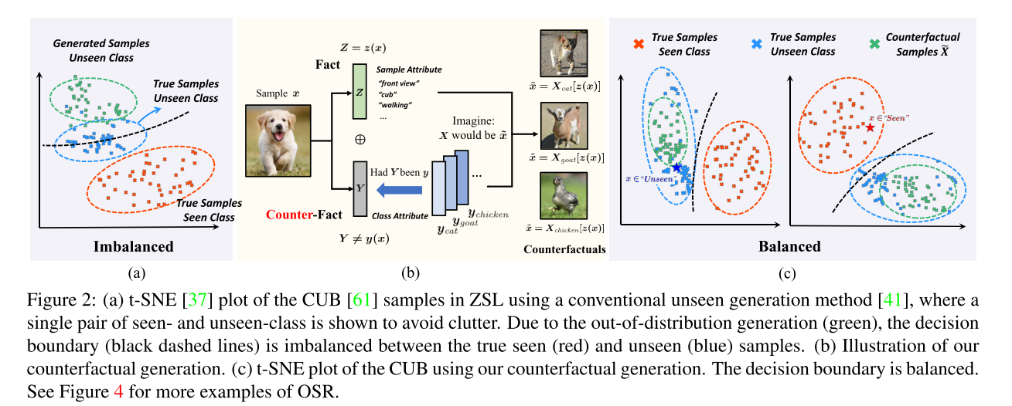
Representative Work3: Counterfactual zero-shot and open-set visual recognition
Motivation: 1) the common challenge of Both Zero-Shot Learning (ZSL) and Open-Set Recognition (OSR) is generalizing to the unseen-classes by only training on the seen-classes. 2) the generated samples for unseen-classes are often out of the true distribution, which causes severe recognition rate imbalance between the seen-class (high) and unseen-class (low).

Slide 69

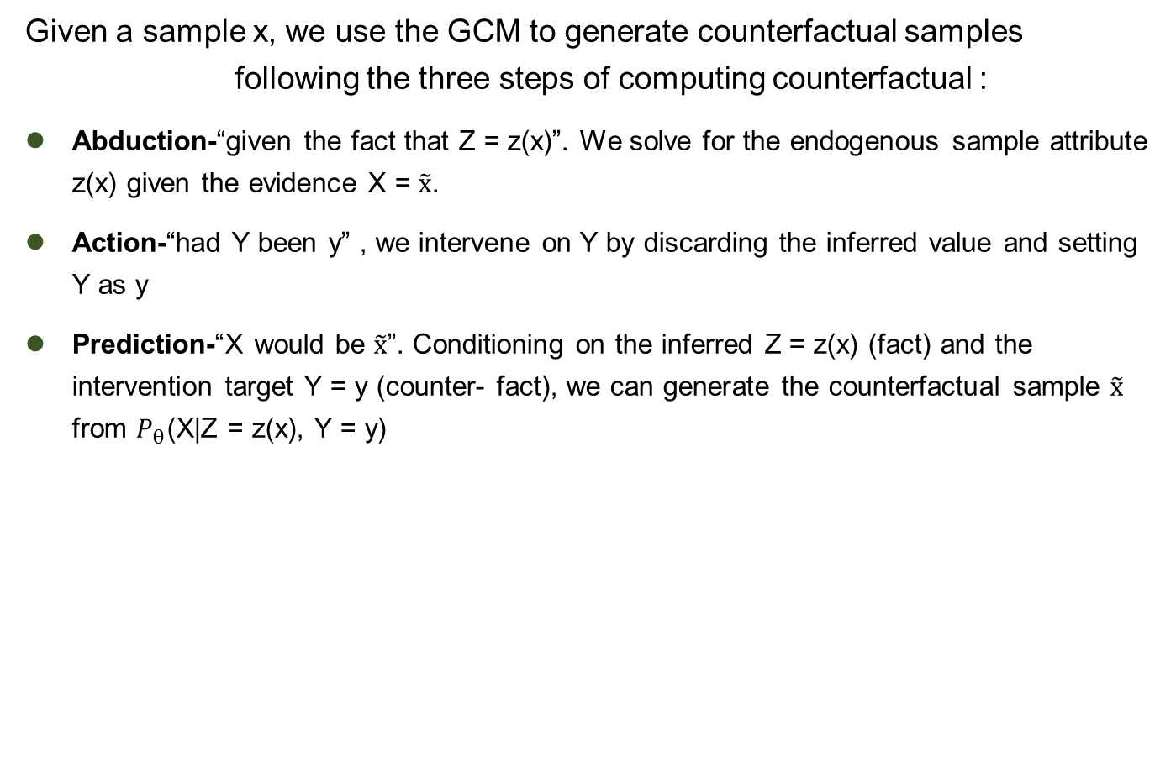
Representative Work3: Counterfactual zero-shot and open-set visual recognition
Given a sample x, we use the GCM to generate counterfactual samples following the three steps of computing counterfactual :
Abduction-“given the fact that Z = z(x)”. We solve for the endogenous sample attribute z(x) given the evidence X = $\tilde{x}$.
Action-“had Y been y” , we intervene on Y by discarding the inferred value and setting Y as y
Prediction-“X would be $\tilde{x}$”. Conditioning on the inferred Z = z(x) (fact) and the intervention target Y = y (counter- fact), we can generate the counterfactual sample $\tilde{x}$ from $P_{θ}$(X|Z = z(x), Y = y)

Slide 70



Representative Work3: Counterfactual zero-shot and open-set visual recognition
We want that the above counterfactual sample lies in the true distribution of the seen or unseen samples.
This allows us to build a binary classifier on seen/unseen by applying the Consistency Rule

Slide 71
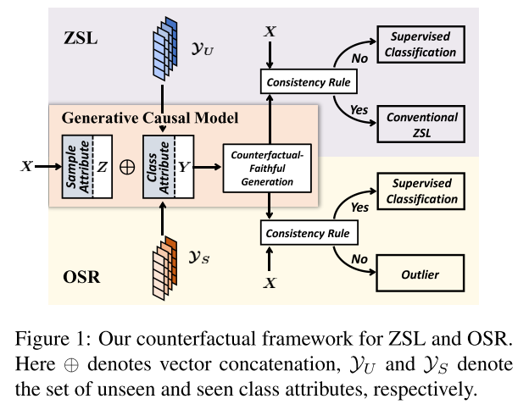
Representative Work3: Counterfactual zero-shot and open-set visual recognition
Method: apply the Consistency Rule to perform unseen/seen binary classification and make the generation is not Counterfactual Faithful

Slide 72
Representative Work4: Cycle-Consistent Counterfactuals by Latent Transformations
Motivation:
CounterFactual (CF) visual explanations try to find images similar to the query image that change the decision of a vision system to a specified outcome.
Existing methods either require inference-time optimization or joint training with a generative adversarial model which makes them time-consuming and difficult to use in practice.

Slide 73
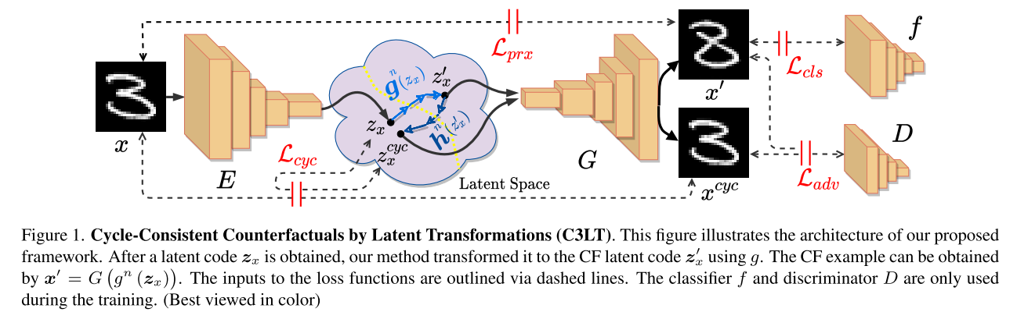
Representative Work4: Cycle-Consistent Counterfactuals by Latent Transformations
Method: 1) It learns a latent transformation that automatically generates visual CFs by steering in the latent space of generative models. 2) It uses cycle consistency between the query and CF latent representations which helps training to find better solutions.

Slide 74
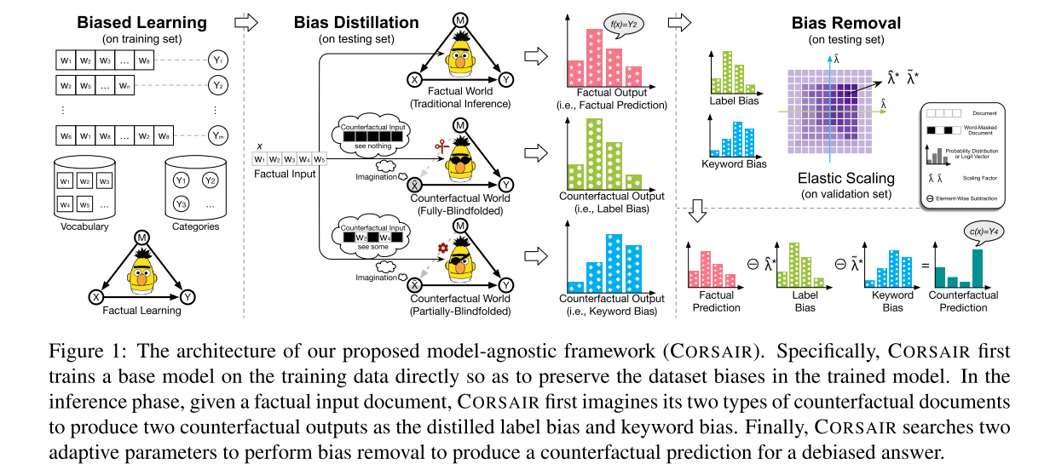
Representative Work5: Counterfactual inference for text classification debiasing
Motivation: Today’s text classifiers inevitably suffer from unintended dataset biases, especially the document-level label bias and word-level keyword bias, which may hurt models’ generalization.

Slide 75
Representative Work5: Counterfactual inference for text classification debiasing
SCM and Method: In inference, given a factual input document, CORSAIR imagines its two counterfactual counter-parts to distill and mitigate the two biases captured by the poisonous model.
Similar to representative work 1

Slide 76
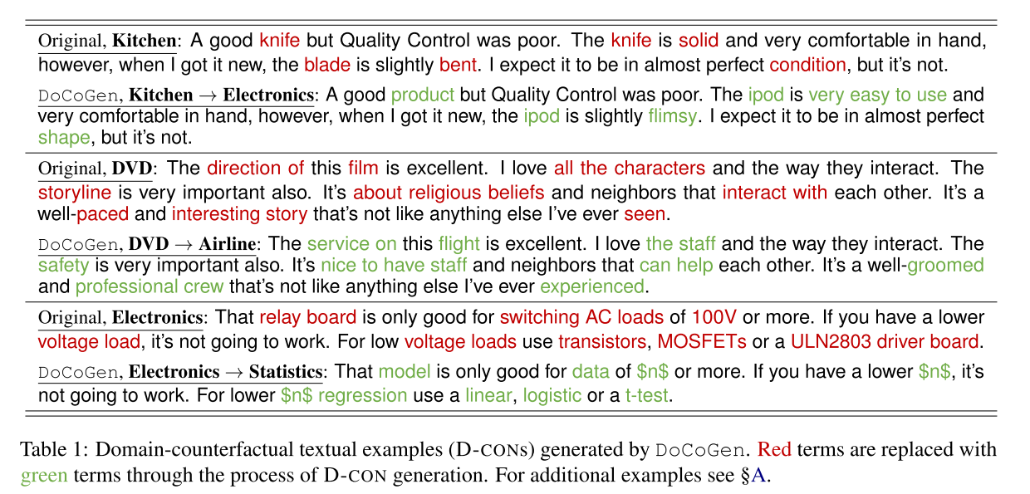
Representative Work6: DoCoGen: Domain Counterfactual Generation for Low Resource Domain Adaptation
Motivation: Natural language processing (NLP) algorithms have become very successful, but they still struggle when applied to out-of-distribution examples.

Slide 77
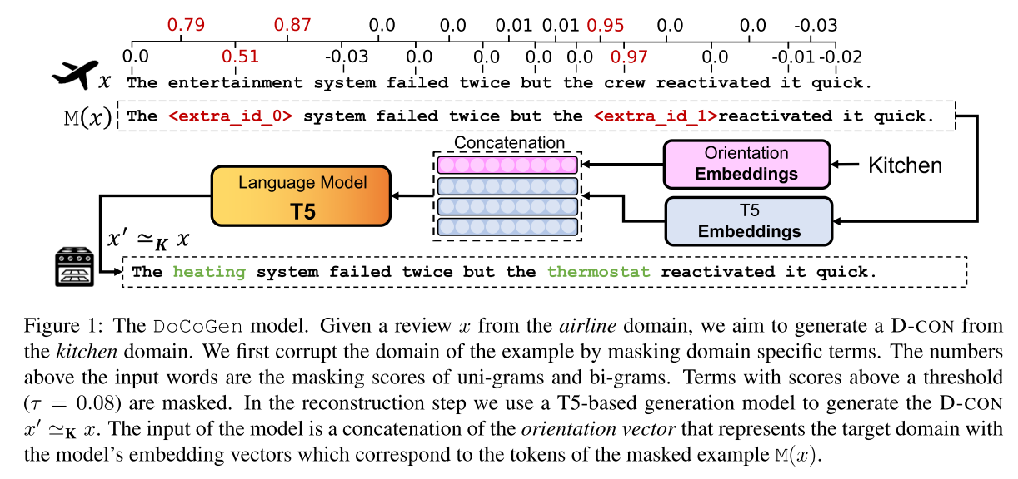
Representative Work6: DoCoGen: Domain Counterfactual Generation for Low Resource Domain Adaptation
Method: Given an input text example, the algorithm generates a domain-counterfactual textual example (D-CON) – that is similar to the original in all aspects, including the task label, but its domain is changed to a desired one
Similar to representative work3

Slide 78
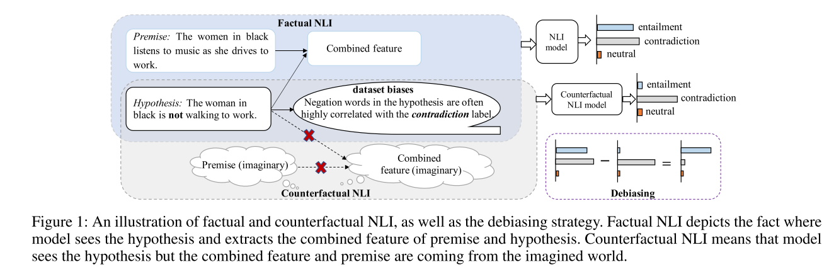
Representative Work7: Debiasing NLU models via Causal Intervention and Counterfactual Reasoning
Motivation: Natural Language Understanding (NLU) models are prone to relying on annotation biases of the datasets as a shortcut, which goes against the underlying mechanisms of the task of interest

Slide 79


Representative Work7: Debiasing NLU models via Causal Intervention and Counterfactual Reasoning
SCM and Method: 1) To remove confounder, the backdoor adjustment with causal intervention is utilized to find the true causal effect during training 2) In inference process, we formulate the bias as the direct causal effect and remove it by pursuing the indirect causal effect with counterfactual reasoning.

Slide 80
Summary
Counterfactuals Basics
Roadmap for Computing Deterministic Counterfactuals
General Steps for Probabilistic Counterfactuals
Important Application: Mediation
CDE、NDE、NIE
When We Can Measure NDE and NIE
Representative Works

Slide 81
Causal Inference
参考：https://www.bradyneal.com/causal-inference-course
https://www.inference.vc/causal-inference-3-counterfactuals/

